Slide 1
Project Description
Michał Pompa, Michaela Golhova, Daniela Koch, Matej Michalek
Notes:
Good morning. I would like to begin by introducing ourselves: My name is Miśka Golhova, Daniela Koch, Matej Michalek, and this is Michał Pompa and we are group 6.
We will present you our project description: What is about, what we will provide and what is the purpose of it.

Slide 2
AGENDA
Background description
Purpose
Problem statement
Delimitation
Notes:
We divided our project in 4 parts which are background description, purpose, problem statement and delimitation.
Now, I would like to pass the floor to my fellow speaker

Slide 3
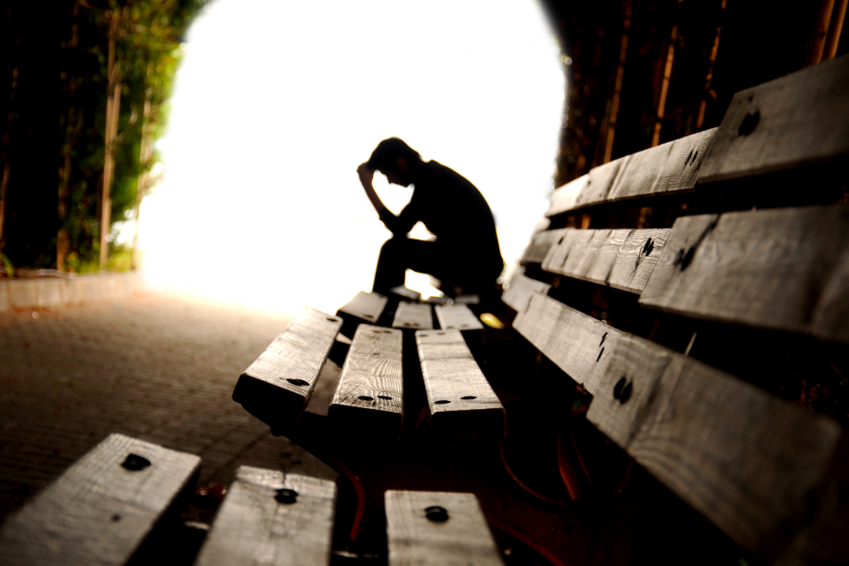
Notes:
First of all, I’d look at background description. We live in times of rush. (pause) Stress and anxiety take control of our live.

Slide 4

Notes:
For this reason, we come up with Vipassana Insight Awareness, which is solution for those problems. We provide seminars, workshops, lectures and trips where people can take advantage of vipasanna’s technics to improve their way of living. We came with traditional Buddhistic methods, which reduce stress and help to fight with depression.

Slide 5
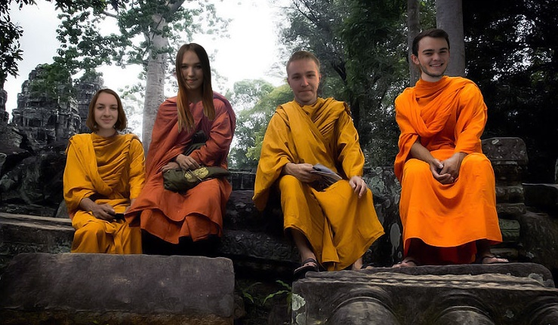
Notes:
Members of Vipassana will be part of the group, which gives them feeling of being important.

Slide 6

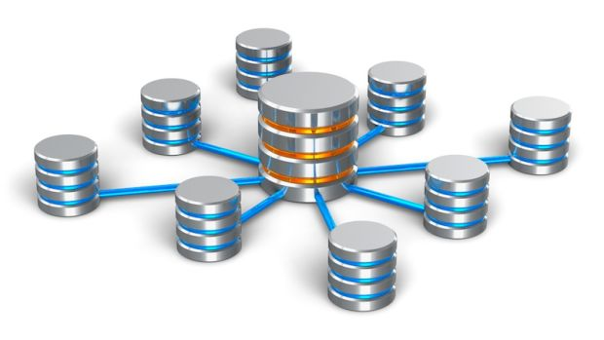
Notes:
However, Vipassanā is not adapted to the today’s world based on new technology. As the world depends more and more on the work of computers, keeping a paper-based system is hardly possible. The organization is in a need of keeping track of events, members, lecturers and the work done by its council in an easy way. It needs a system that would store data and provide an easy access to them.
And now, Miśka is going to talk more about details of the system.
I would like start with purpose. The purpose is to make a server that enables storing data and easy access to them.
However, we mustn’t underestimate the importance of problems that we will face. Project is focused on making data available for users in object-oriented way. The server will be responsible for collecting data from users and storing them in files. Users will be able to retrieve data from the server on request.

Slide 7
How to store data in files?
How to search for specific values in data?
How to make the system maintainable?
How to make the system scalable?
Notes:
Questions to be answered are following:
● How to store data in files?
● How to search for specific values in data?
● How to make the system maintainable(mejntejnbl), i.e. relatively easy to provide database compatibility?
● How to make the system scalable – e.g. from 2 to 200 lecturers?

Slide 8

Notes:
Firstly, we will not use database to store data. Secondly, data will be provided by files, not from real users.
Those are the main points of our project description. We described ideas of VIA, purpose of our project, and problems that we will have to deal with. We also mentioned its boundaries

Slide 9
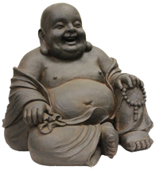
Any questions?
Notes:
And now, if you have any questions, I’ll be glad to answer them.

Slide 10
THANK YOU FOR YOUR ATTENTION!

